Slide 1
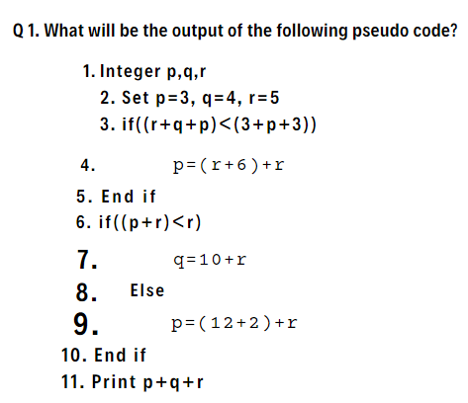
Accenture 3 May Exam Analysis:
Options:
32
34
26
28

Slide 2
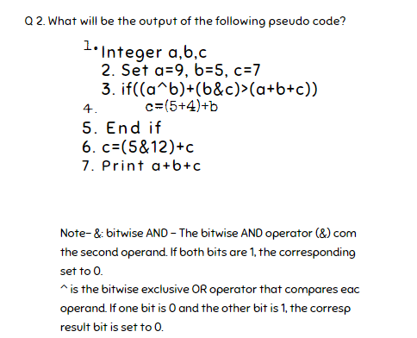
Accenture 3 May Exam Analysis:
Options
23
25
33
26

Slide 3
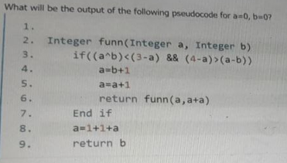
Accenture 3 May Exam Analysis:
Q3.
4
6
2
14

Slide 4
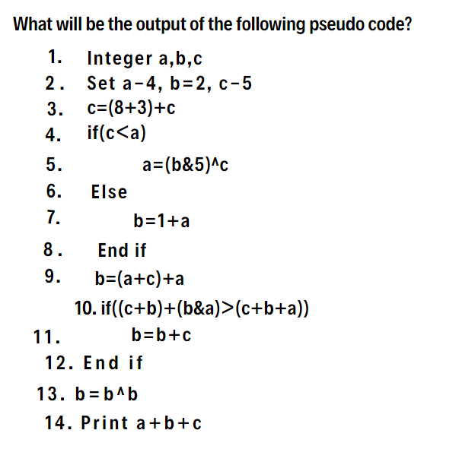
Accenture 3 May Exam Analysis:
Q4.

Slide 5
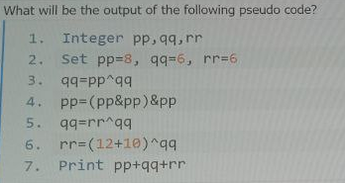
Accenture 3 May Exam Analysis:
Q5.

Slide 6
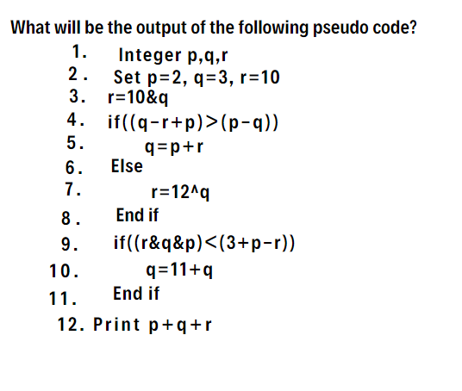
Accenture 3 May Exam Analysis:
Q6.

Slide 7
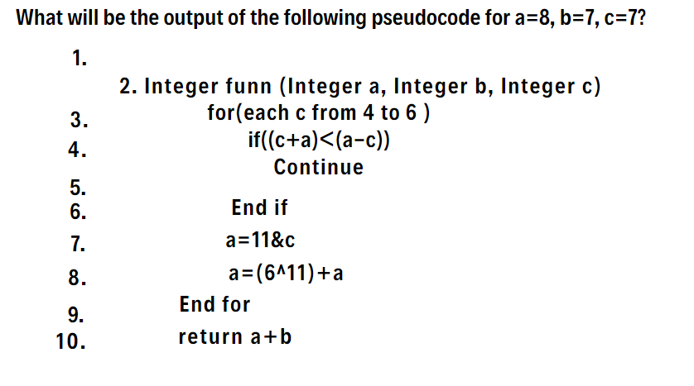
Accenture 3 May Exam Analysis:
Q7.
22
36
18
24

